Slide 1

RUNGTA COLLEGE OF DENTAL SCIENCES & RESEARCH
TITLE OF THE TOPIC- ROOT RESORPTION
DEPARTMENT OF CONSERVATIVE DENTISTRY AND ENDODONTICS

Slide 2
Specific learning Objectives
At the end of this presentation the learner is expected to know ;
Core areas* | Domain ** | Category #
Introduction | Cognitive | Must know
Classification | Cognitive | Must know
Methods | Psychomotor | Must know
*Subtopic of importance
** Cognitive, Psychomotor or Affective
# Must know , Nice to know & Desire to know
( Table to be prepared as per the above format )

Slide 3
CONTENTS
Introduction
Definition
History
Classifications
Mechanism of resorption
Regulatory factors
Systemic regulatory factors
Local regulatory factors
Resorption due to systemic causes
Resorption due to local causes
Problems in working length determination
Role of emdogain
Periodontal regeneration
Repair of resorption
Conclusion
References

Slide 4
Nomenclature
  Odontoclastoma (Fish,1941)
  Idiopathic external resorption (Wade,1960)
  Fibrous dysplasia of tooth (Wade,1960)
  Peripheral cervical resorption (Southam,1967)
  Cervical external resorption (Makkes, Velsen,1975)
  External-internal resorption (Frank,1975)
  Extracanal invasive resorption (Frank,1981)
  Late external resorption (Cvek, 1981)
  Cervical resorption (Tronstad,1988)
  Peripheral inflammatory root resorption (Gold,Hasselgren,1992)
  Invasive resorption (Bakland,1992)
  Progressive intradental resorption (Lepp,1969)
  Burrowing resorption (Barclay,1993)
  Pseudo pink spot
  Resorption extra camerale
  Invasive cervical resorption (Heithersay,1999)
  Subepithelial external root resorption (Trope,2002)
  Periodontal infection root resorption (Fuss et al,2003)

Slide 5
Features
Characterized by invasion of the root by fibrovascular tissue derived from PDL.
Often aggressively destructive
Resorption surrounds the root canal without invading the pulp.
Most often referred to as “cervical root resorption” as it occurs immediately below the epithelial attachment of the tooth usually but not exclusively in the cervical area of the tooth.

Slide 6
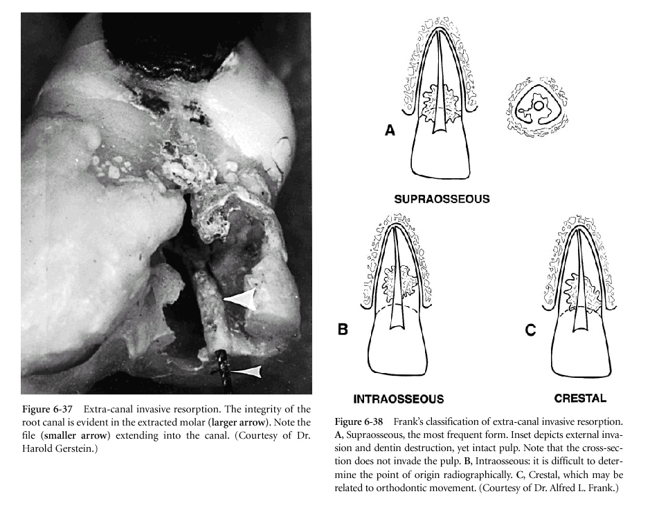
Classification
Frank et al
Most frequent form
Difficult to determine point of origin radiographically
May be related to orthodontic movement

Slide 7
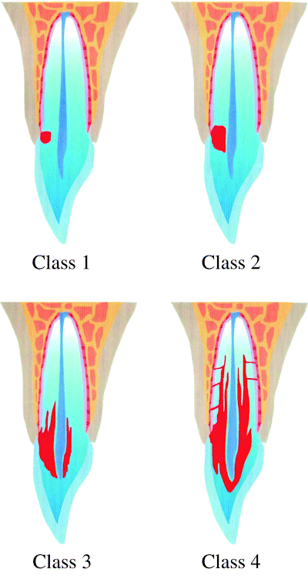
Heithersay’s Classification (Based On Severity)
Small invasive resorptive lesion near
the cervical area with shallow penetration into dentin
Well defined lesion penetrated close to the coronal pulp chamber but shows little or no extension into radicular
dentin
Deeper invasion of dentin by resorbing tissue, not only involving the coronal dentin but also extending at least to the coronal third of the root.
Large invasive resorptive process that has extended beyond the coronal third of the root canal

Slide 8
Etiology
Injury to the attachment apparatus (periodontal ligament or cementum) immediately below the epithelial attachment of the root either by orthodontic tooth movement, trauma or non-vital bleaching and other less definable cause.
Source of stimulation (infection) is the bacteria in the sulcus of the tooth / periodontal infection.
Bone resorption similar to marginal periodontitis will always accompany this type of root resorption.

Slide 9
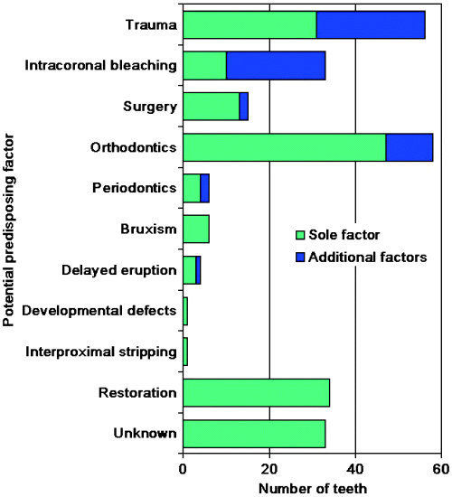

Slide 10
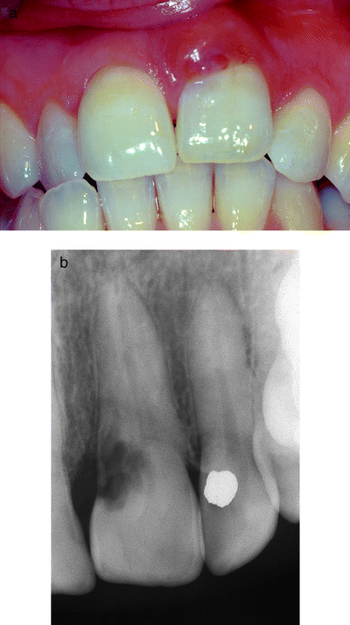
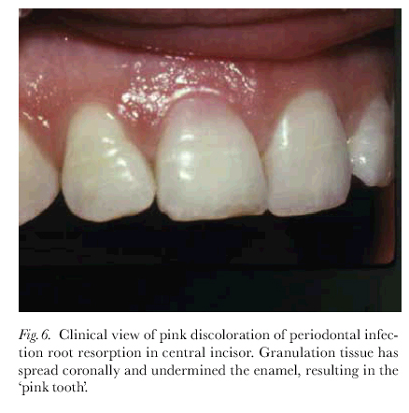
Clinical evaluation
Tooth is asymptomatic.
If extensive, symptoms of pulpitis will develop.
Pulp tests are vital except in cases due to intracoronal bleaching
Probing may result in profuse bleeding because of presence of inflamed tissue rather than normal attachment
‘PINK SPOT'
When the resorption is long-standing granulation tissue spreads coronally to undermine the enamel of the crown of the tooth, resulting in a pinkish appearance
Usually misdiagnosed as internal resorption.

Slide 11
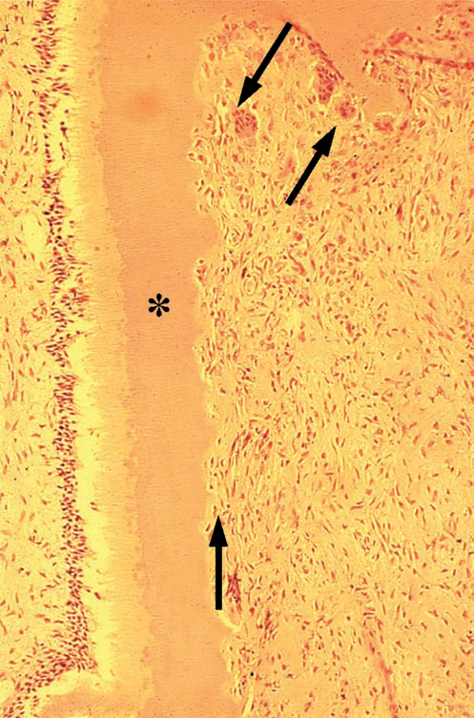
Histologic appearance
Appears similar to any external inflammatory root resorptive process.
Usually seen as a small opening into the root with large amounts of granulomatous tissue inside the defect with multinucleated giant cells resorbing the dentinal structure.
In extensive defects, osseous tissue seen inside the granulomatous tissue indicating quiescent periods in the process where healing with reformation of an attachment may have been attempted.
Even in the most extensive defects, the predentin/odontoblastic layer is unaffected

Slide 12
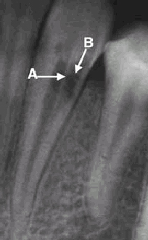
Radiographic appearance
Occurs mesially or distally on the root surface.
A small radiolucent opening into the root could be misdiagnosed as root caries, but pulp is vital in these cases.
Radiolucency expands coronally and apically in the dentin, and reaches, but usually does not perforate, the root canal.
Notes:
Resorptive process occurs mesially or distally on the root surface. A small radiolucent opening into the root could be misdiagnosed as root caries, but pulp is vital in these cases.
The radiolucency expands coronally and apically in the dentin, and reaches, but usually does not perforate, the root canal.

Slide 13
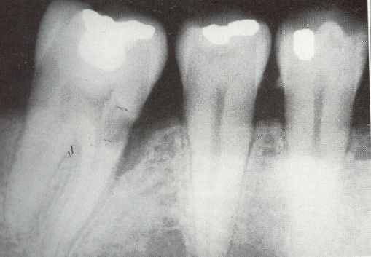
Presence of radiolucency associated with bone could be misdiagnosed as infrabony pocket

Slide 14
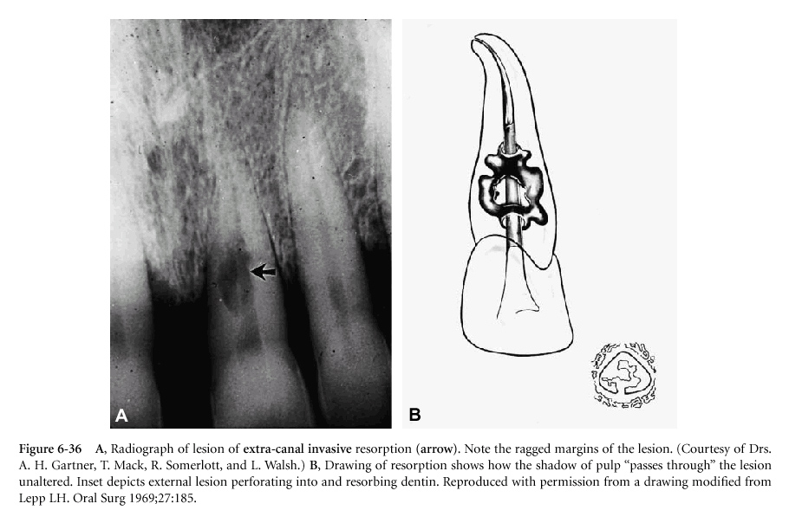
When resorptive process is buccal or palatal-lingual diagnosis becomes difficult. It must be differentiated from internal resorption by noting the:
-Ragged margins of the lesion
-Shadow of pulp passes through the lesion unaltered

Slide 15
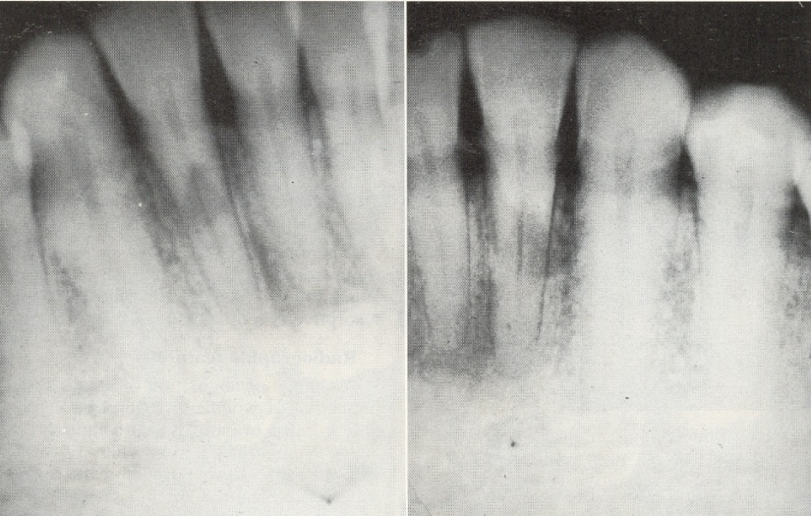
Angled radiographs
Lesions due to external resorption shift on changing the angulation

Slide 16
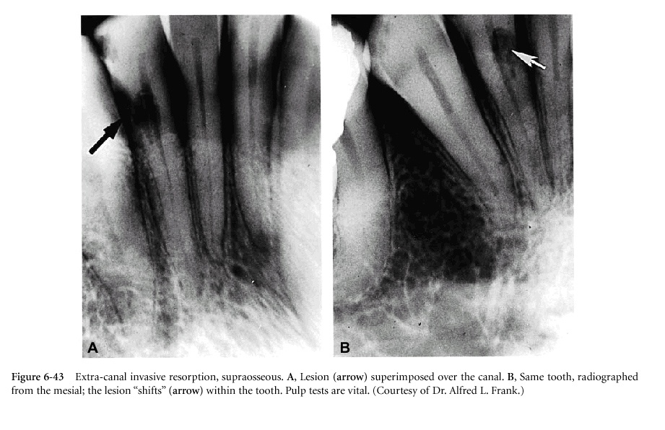
Buccal object rule

Slide 17
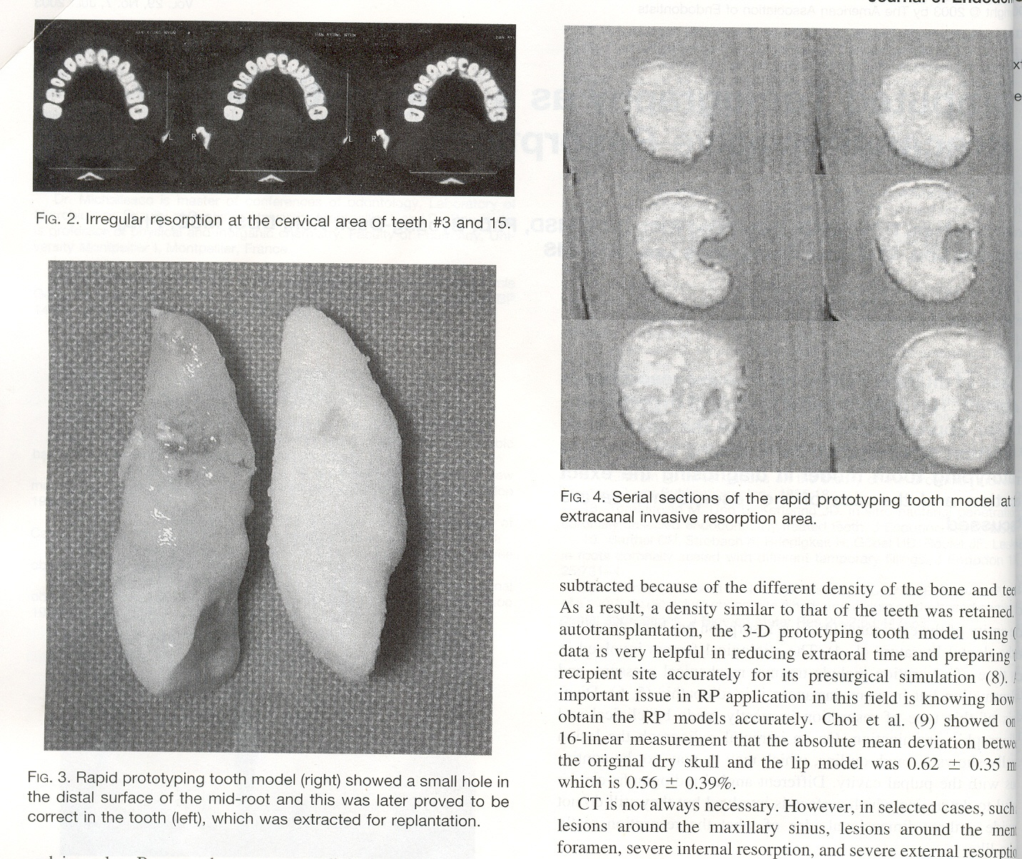
CARP (Computer Assissted Rapid Protoyping)
Using computed tomography

Slide 18
Treatment
The aim of treatment is two-fold
Stop continuation of resorption by removing all the granulomatous tissue from the root
Severe the blood supply to the granulomatous tissue.

Slide 19
Treatment approaches
Internal approach (without raising flap)
External approach (raising flap)
Combination

Slide 20
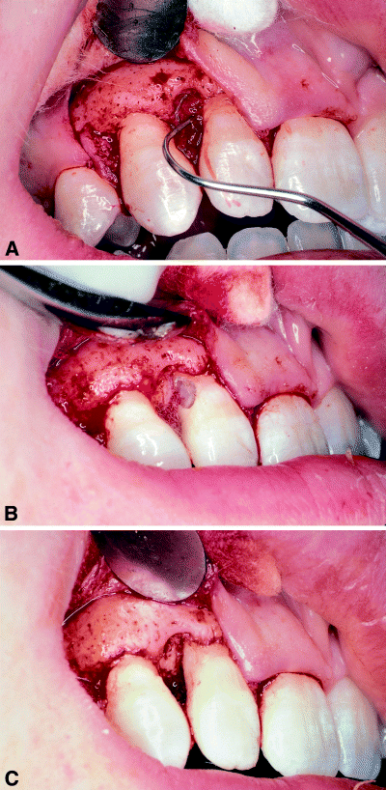
Heithersay Class 1 or 2
External approach
Determine the exact location of the defect (buccal or lingual-palatal) via angled radiographs or CARP
A full thickness flap is raised.
Granulomatous tissue is removed from the root and the bone defect with a curette or bur.
The root defect is filled with a restorative material. Flap is replaced in a way as to minimize the periodontal defect after healing
Notes:
Localized defect entirely within the coronal third of the tooth or close to the cervical margin

Slide 21
Internal Approach
-Trichloracetic acid
The acid will chemically burn the granulomatous tissue, thus necrosing it and providing space for the filling material internally
(Heithersay 1999)
-Calcium hydroxide
But may take multiple applications to achieve the same results
Goefferey et al.

Slide 22
Hiethersay Class 3
External
Traditional approach is to remove the entire root cementum surface adjacent to the granulomatous tissue in the dentin
Notes:
Alternate approach is to remove the resorptive tissue from a small opening at the most apicaextent of the affected root leaving coronal root surface onto which a new attachment might develop. Opening is repaired with an acceptable restorative material. The defect and denuded root surface is covered with a spacer (freeze-dried bone), and the entire area covered with a Gore-Tex membrane (Gore Tex, W. L. Gore, Flagstatt, AZ).
Forced eruption is performed if the remaining root apical to the resorption defect is long enough to maintain the tooth. The resorption defect is moved to a position coronal to the adjacent attachment. Defect is cleaned and restored.
Forced eruption/re-intrusion is done if the crown root ratio is not ideal. After the repair is complete the tooth can be orthodontically moved into its original position.
Intentional replantation is done if the practitioner is confident that the resorbed root will not fracture on extraction. It is done with or without re-intrusion.

Slide 23
Alternate approach
Remove resorptive tissue from a small opening apical extent leaving coronal root surface onto which a new attachment might develop
Defect and denuded root is covered - a spacer (freeze-dried bone) & entire area covered with Gore-Tex membrane
Forced eruption is performed .resorption defect is moved to a position coronal to the adjacent attachment. Defect is cleaned and restored.
Opening is repaired with an acceptable restorative material

Slide 24
Forced eruption/re-intrusion is done if the crown root ratio is not ideal. After the repair is complete the tooth can be orthodontically moved into its original position.
Intentional replantation is done if the practitioner is confident that the resorbed root will not fracture on extraction. It is done with or without re-intrusion
Elective endodontic therapy is often the best choice in extensive lesions

Slide 25
Heithersay Class 4
Offers poor prognosis.
Extraction and replacement with an implant or fixed bridge is the preferred approach

Slide 26
RESORPTION DUE TO LOCAL CAUSES
1. Inflammation
B) Internal resorption

Slide 27
Internal root resorption
Internal root resorption is the progressive destruction of intraradicular dentin and dentinal tucules along the middle and apical thirds of the canal walls as a result of clastic activities.
Shanon et al 2010
Synonyms are:
Perforating hyperplasia of the pulp
Internal granuloma,
Odontoclastoma,
Pink tooth of mummery

Slide 28
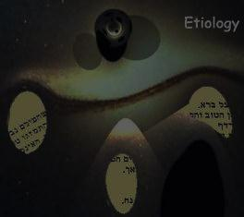
Caries
Calcium hydroxide procedures like vital pulpotomy and pulp capping
Vital root resections
Orthodontics
Bruxism
Diathermy
Anachoresis
Radioactive material
Cracked tooth
Unerupted tooth
Presence of chronic inflammatory tissue in the pulp
Idiopathic
Etiology
When the odontoblastic layer and predentin are lost or altered due to trauma. Most common cause being luxation injuries.

Slide 29
Features
A vital pulp is required for resorption to occur. Communication between the coronal necrotic tissue and the vital pulp is through appropriately oriented dentinal tubule. (Tronstad 1988)
Highest incidence in incisors.
Not usually associated with any systemic disease.

Slide 30
Features
Root resorptions appear to be more frequent close to blood vessels and in areas of active hyperemia with high oxygen pressure and with electrical activity such as piezoelectricity and streaming potentials (charges arising from blood flow through the vessels).
Characterized by an oval-shaped enlargement of the root canal space

Slide 31
TAKE HOME MESSEGE/ FOR THE TOPIC COVERED (SUMMARY)
Tooth resorption is a perplexing problem for all dental practitioners. The etiologic factors are vague, diagnoses are educated guesses, and often the chosen treatment does not prevent the rapid disappearance of the calcified dental tissues.

Slide 32
Question & Answer Session
Write a short note on repair of resorption.
Short note on idiopathic resorption.
Short note on internal inflammatory resorption.
Write in brief classification of resorption.

Slide 33

REFERENCES

Slide 34
Martin Trope, Noah Chivian ; Root Resorption : Pathways of Pulp Cohen and Burns, 6th Edition.
Fuss Z, Tsesis I, Lin S. : Root resorption – diagnosis, classification and treatment choices based on stimulation factors. Dent Traumatol 2003:19:175-182.
M. Laux, P.V. Abbott, G. Pajarola and P.N.R. Nair : Apical inflammatory root resorption : a correlative radiographic and histological assessment : International Endodontic Journal , 33, 483-493, 2000.
Ne RP, Witherspoon DE, Glutman JL: Tooth resorption. Quintessence Int. 30:9-25, 1999.
J.O. Andreasen : Response of oral tissues to trauma. M. Torabinejad and R.D. Finkelman, inflammation and mediators of hard tissue resorption.

Slide 35


